Slide 1
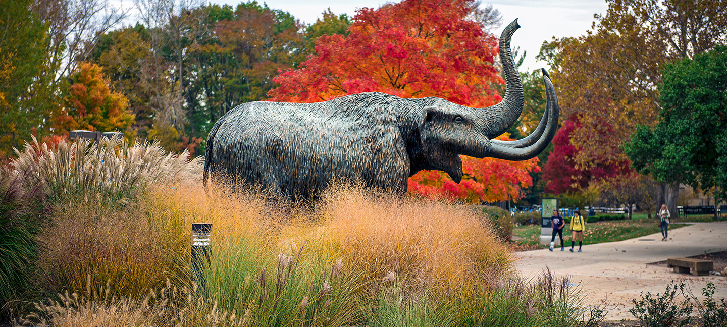
Student Research & Creative
Endeavor Symposium
Friday, March 24, 2023
Sponsors:
Office of Academic Affairs
University Research and Innovation
Honors Program
Helmke Library

Slide 2
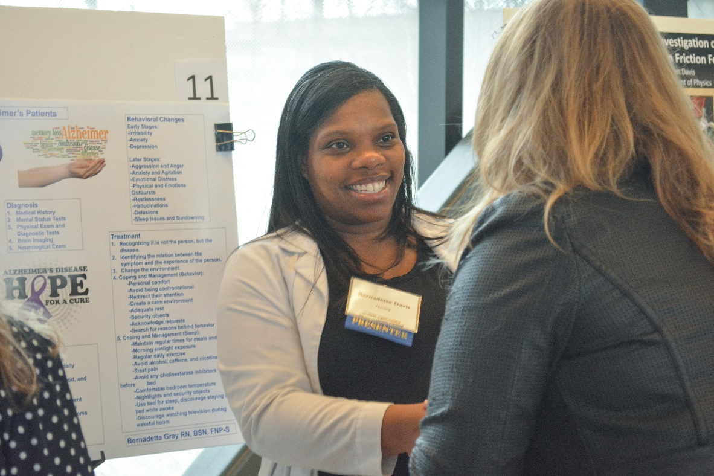
What is the Student Research and Creative Endeavor Symposium?
The annual Student Research and Creative Endeavor Symposium provides an excellent opportunity for undergraduate and graduate students to present posters on research and creative endeavors to an audience of faculty and student peers.

Slide 3
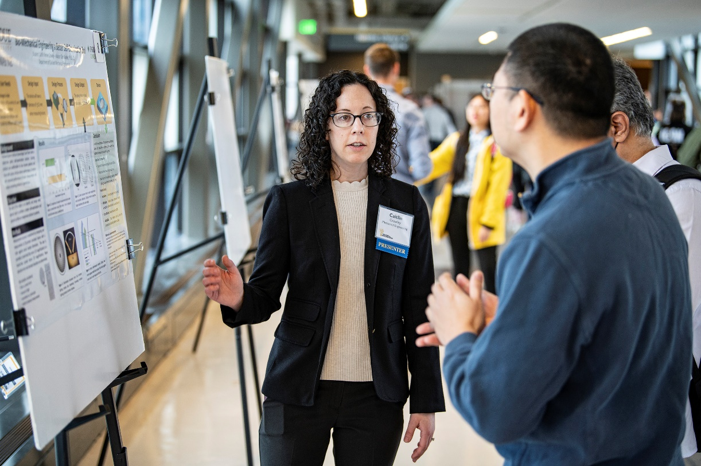
Who can participate?
The symposium is open to all disciplines at Purdue Fort Wayne and IU Fort Wayne. Individual presenters and groups are welcome to present.

Slide 4
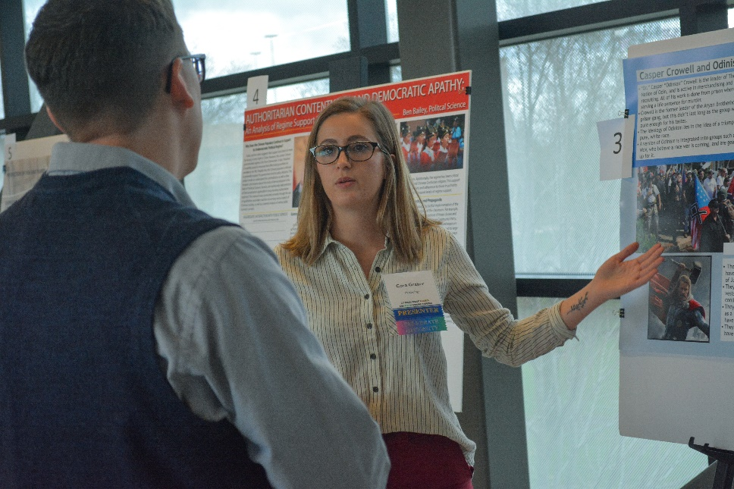
How do I get started?
Ask a faculty member to be your sponsor.
Use your existing research paper/creative endeavor, write and submit your abstract to be reviewed.
Register to present your research to teams of faculty judges.

Slide 5

Design your research poster
Poster templates and technical help are available!
Included on the poster:
What are the reasons behind this project?
What did you set out to do?
What were the study’s hypotheses or questions?
Why it is important?

Slide 6
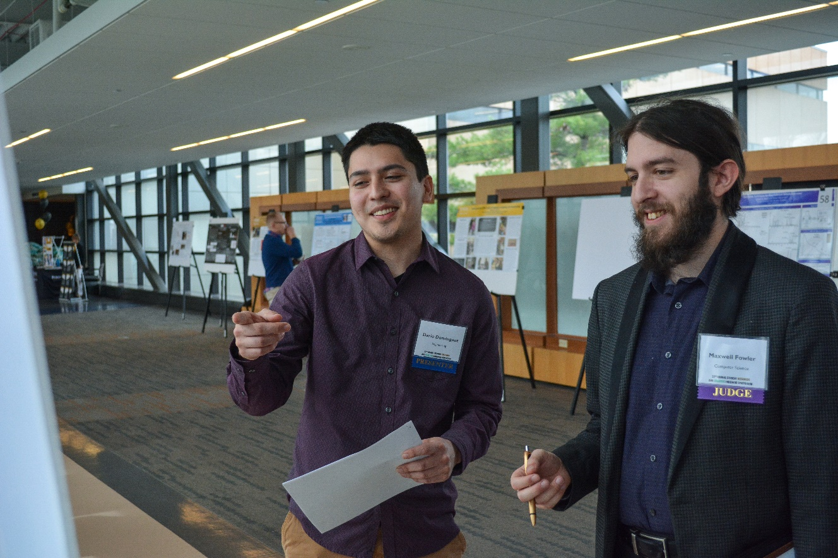
Present your research.
Prepare to give a 5-7 minute summation of your research to teams of faculty judges during your scheduled session. You will never have to miss class to present at the symposium.

Slide 7
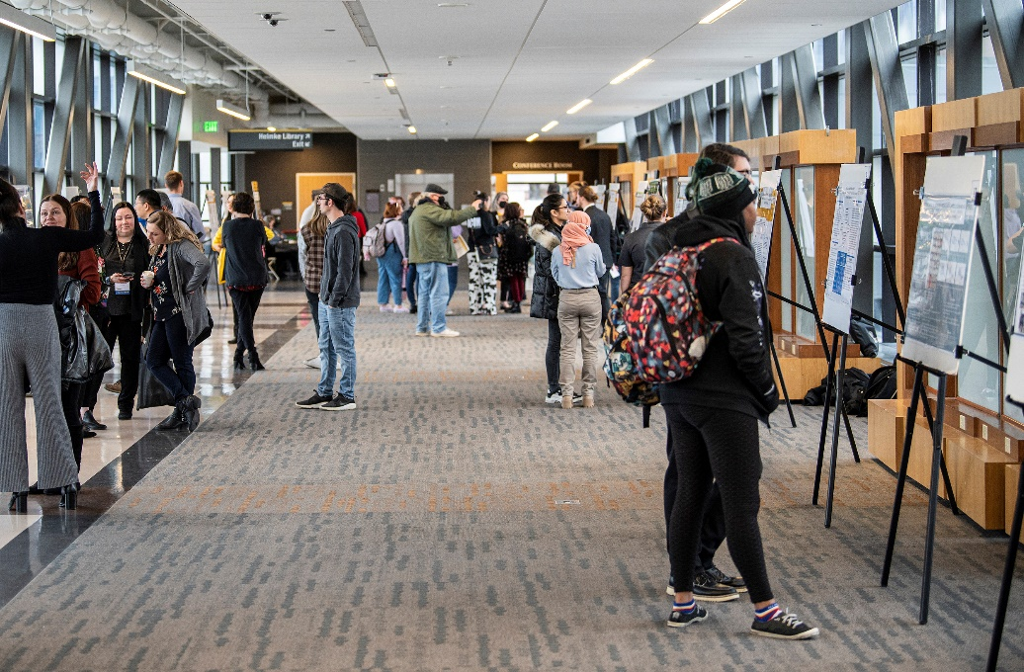
Join us!
Join us!
Friday, March 24, 2023
9am – 3pm
2023 Student Research and Creative Endeavor Symposium
https://www.pfw.edu/centers/irsc/research-symposium/

Slide 8
Questions?
Contact
University Research and Innovation
SRSymposium@pfw.edu

